Slide 1
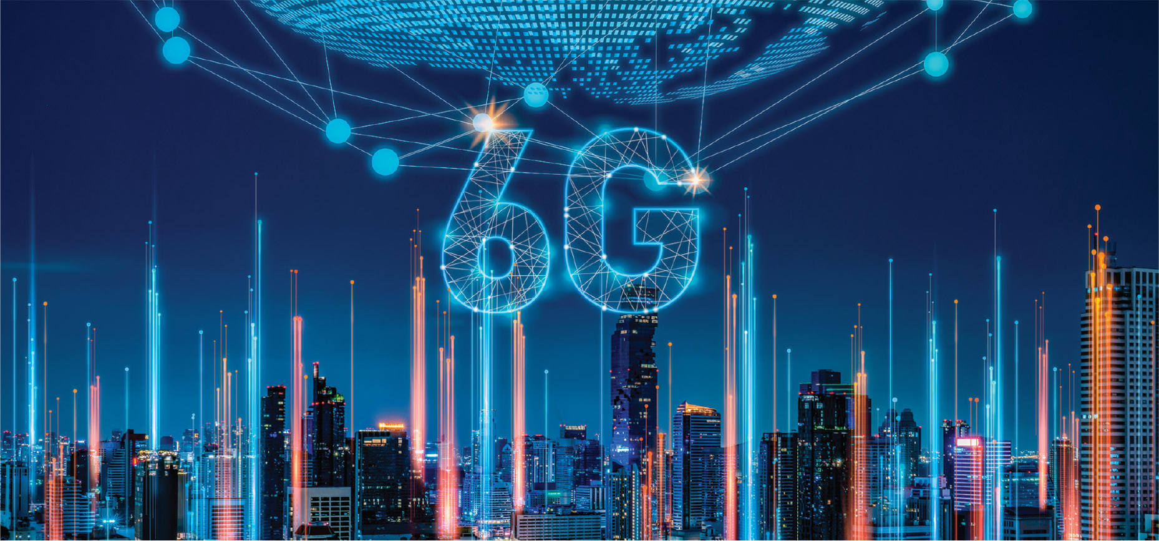
6G-The future of networking
Module 1:What is 6G????
6G is the sixth generation of wireless technology, expected post-2030. It evolves beyond 5G's connectivity
BY TUMWESIGYE MARK

Slide 2
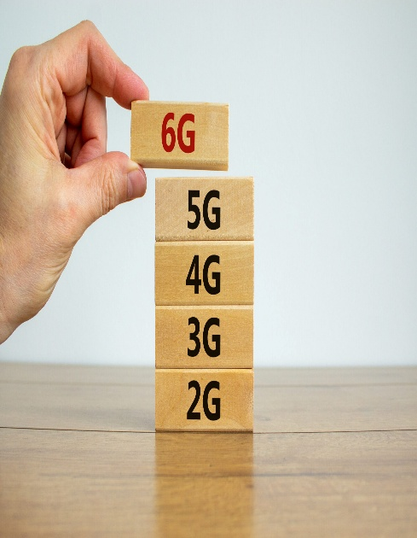
Module 2: The Evolutionary Path: 1G to 5G
1G-2G: Voice & Text.
3G: Basic Mobile Internet.
4G: Mobile Broadband (Streaming, Apps).
5G: IoT, Low Latency

Slide 3
Module 3: Why 6G?
6G is being developed to surpass the capabilities of 5G.
Key benefits and advancements of 6g
Higher performance-high latency (speeds of thousands of giga bytes
Advanced applications(networked vehicles,virtual reality)
AI Intergration-Ai will be the core component
Enhanced connectivity and relliability (extending coverage to remote areas)
Improving security (protect against cyber threat and improve privacy

Slide 4
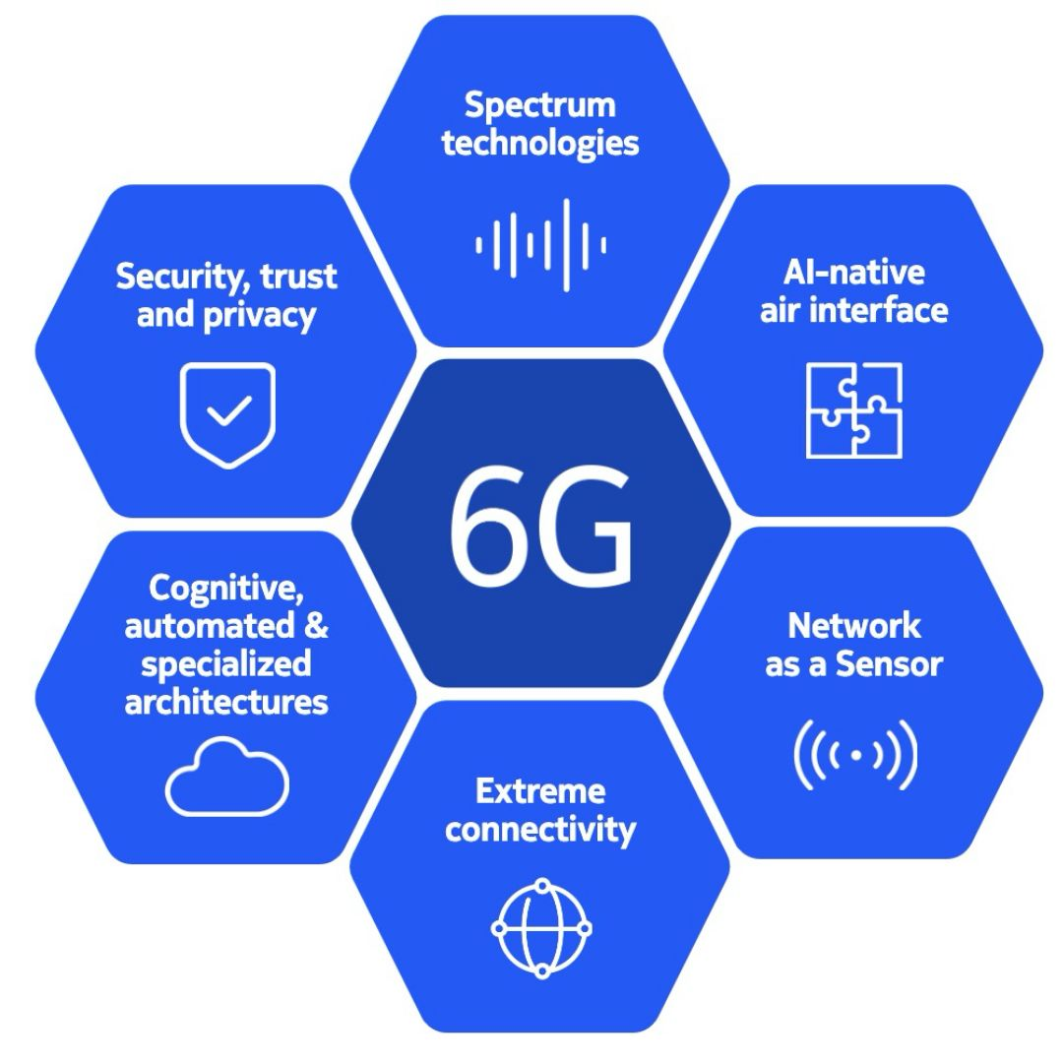
Module 4: Core 6G Technologies & KPIs
Peak Data Rate
Latency
Connection Density
Spectral Efficiency (what maximum amount of data can be transferred over a given period in a specific range of frequency)
Sensing and computing

Slide 5

Module 5: The Immersive Future: Holograms & Sensing
6G will make real-time, high-fidelity holographic communication and multi-sensory internet (touch, smell) a reality, powering truly immersive metaverse and telepresence experiences.

Slide 6
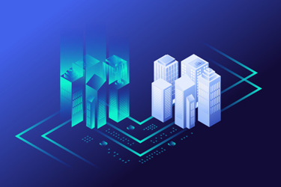
Module 6: Intelligent Worlds: Digital Twins & Automation
6G enables high-precision Digital Twins—virtual replicas of physical systems—for simulation and remote control. This is critical for smart factories, coordinated robot swarms, and remote surgery.

Slide 7
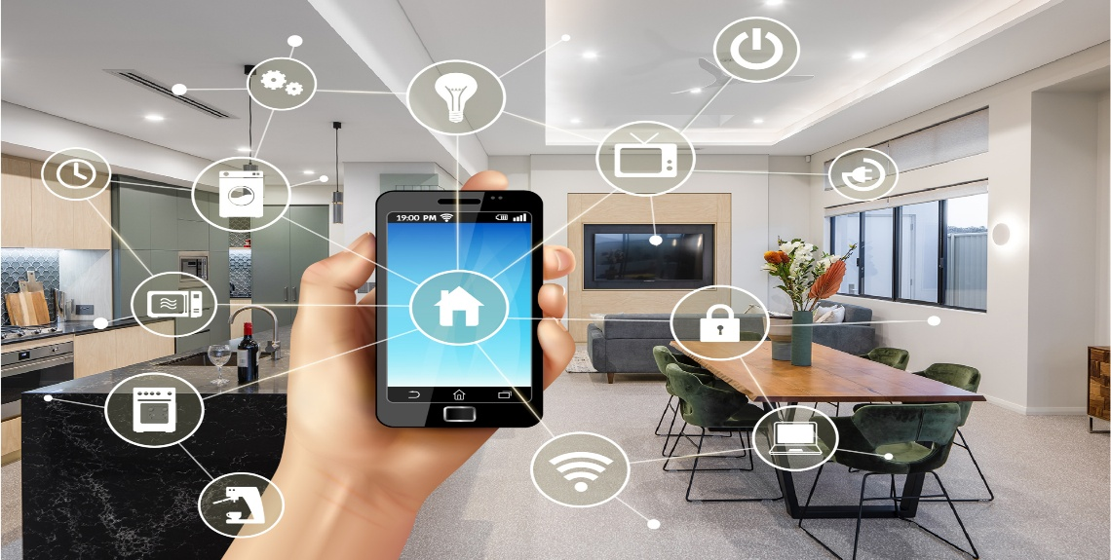
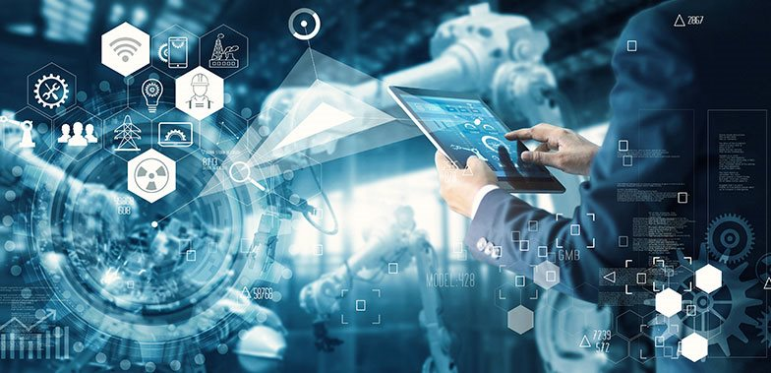
Module 7: Applications for a Sustainable World
· Precision Agriculture: Optimizing water and crop yields.· Environmental Monitoring: Real-time tracking of climate and pollution.· Smart Energy Grids: Efficient management of renewable resources.

Slide 8
Module 8: Key Challenges to Overcome
Infrastructure: Cost of ultra-dense network deployment.·
Energy: Balancing performance with sustainability.
Security: Protecting a vastly more complex network.

Slide 9
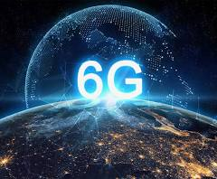
Module 9: Conclusion: Envisioning the 6G Era
6G is not just faster internet; it is a foundational platform for future innovation. It promises to redefine industries, address global challenges, and seamlessly blend our physical and digital realities

